Slide 1
Design and analysis of algorithms (CSE 2012)
Prepared by
Dr.S.Jenicka
Assistant professor senior grade 2
SCOPE-Analytics
VIT Vellore

Slide 2
Dynamic programming
Dynamic programming is a technique for solving problems with overlapping subproblems. Typically, these subproblems arise from a recurrence relating a given problem’s solution to solutions of its smaller subproblems. Rather than solving overlapping subproblems again and again, dynamic programming suggests solving each of the smaller subproblems only once and recording the results in a table from which a solution to the original problem can then be obtained.

Slide 3
Dynamic programming and memoization
When you solve a dynamic programming problem using tabulation you solve the problem "bottom up", i.e., by solving all related sub-problems first, typically by filling up an n-dimensional table. Based on the results in the table, the solution to the "top" / original problem is then computed.
If you use memoization to solve the problem you do it by maintaining a map of already solved sub problems. You do it "top down" in the sense that you solve the "top" problem first (which typically recurses down to solve the sub-problems

Slide 4
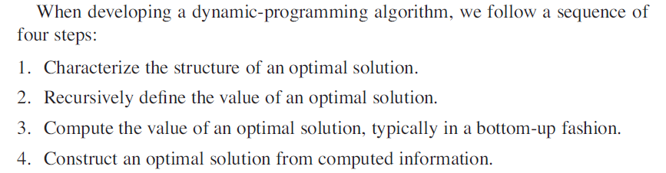
-Contd

Slide 5
Longest common subsequence (LCS) problem
The Longest Common Subsequence (LCS) problem is finding the longest subsequence present in given two sequences in the same order.

Slide 6
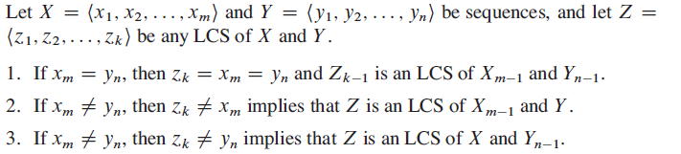
1. Characterizing Longest common sequence -Optimal sub structure of an LCS

Slide 7
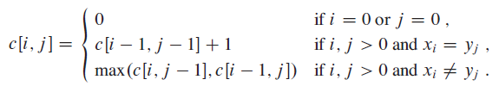

2. A recursive solution
To find an LCS of X =<$x_{1},x_{2⋯}$, $x_{m}$ >; and Y =<$y_{1},y_{2⋯}$, $y_{n}$ >. If $x_{m}$= $y_{n}$we must find an LCS of $x_{m−1}$and $y_{n−1}$. Appending $x_{m}$= $y_{n}$to this LCS yields an LCS of X and Y . If $x_{m}≠$ $y_{n}$, then we must solve two subproblems: finding an LCS of $x_{m−1}$and Y and finding an LCS of X and $y_{n−1}$ whichever of these two LCSs is longer is an LCS of X and Y .

Slide 8
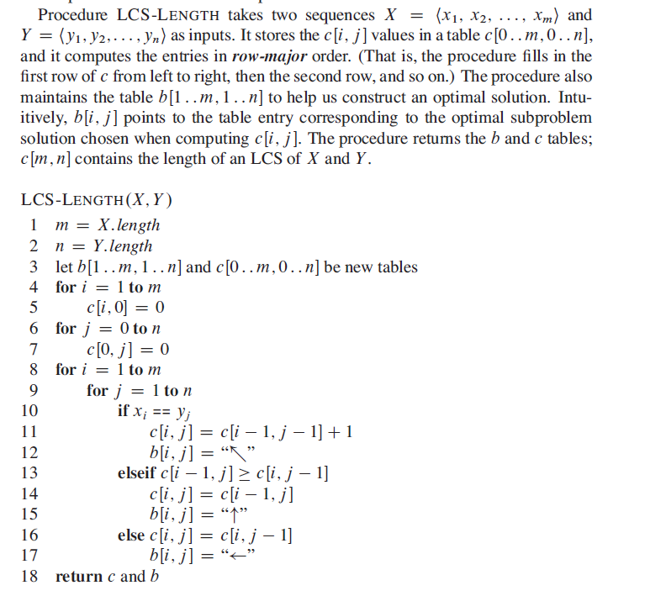
3. Computing the length of an LCS

Slide 9
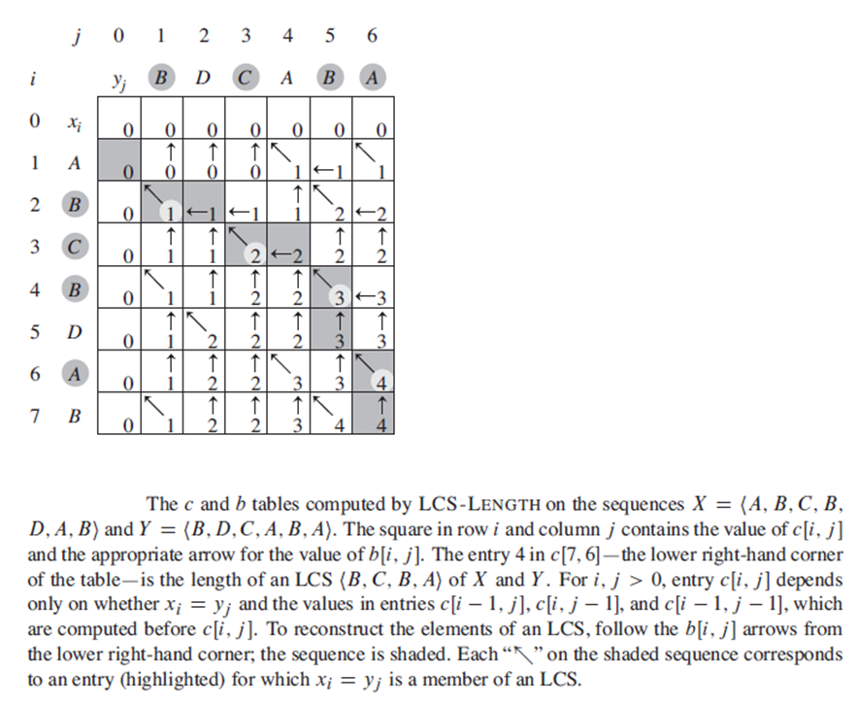
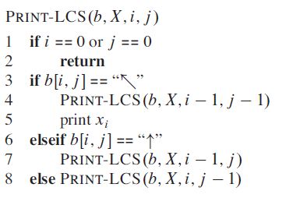
4. Construct an LCS

Slide 10
Runtime complexity of LCS problem
In brute force, the time complexity of finding the length of the longest common subsequence between two sequences will be O(n * 2^{n}). When the problem is solved using dynamic programming it is O(2^n) in the worst case and the worst case happens when all characters of X and Y mismatch i.e., length of LCS is 0.

Slide 11
Matrix chain multiplication
Given a sequence of matrices, find the most efficient way to multiply these matrices together. The problem is not actually to perform the multiplications, but merely to decide in which order to perform the multiplications. We have many options to multiply a chain of matrices because matrix multiplication is associative. In other words, no matter how we parenthesize the product, the result will be the same. For example, if we had four matrices A, B, C, and D, we would have:
(ABC)D = (AB)(CD) = A(BCD) = ....
However, the order in which we parenthesize the product affects the number of simple arithmetic operations needed to compute the product, or the efficiency. For example, suppose A is a 10 × 30 matrix, B is a 30 × 5 matrix, and C is a 5 × 60 matrix. Then,
(AB)C = (10×30×5) + (10×5×60) = 1500 + 3000 = 4500 operations
A(BC) = (30×5×60) + (10×30×60) = 9000 + 18000 = 27000 operations.

Slide 12
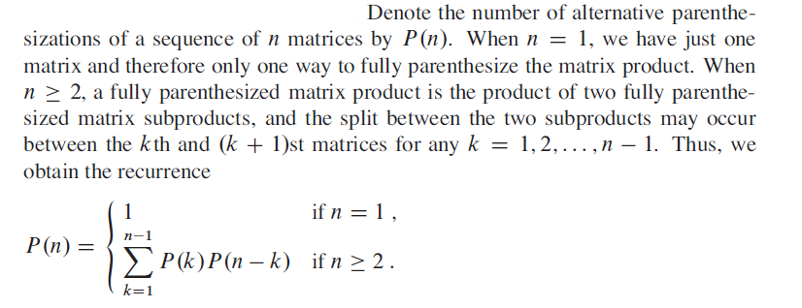
Counting the number of paranthesizations

Slide 13
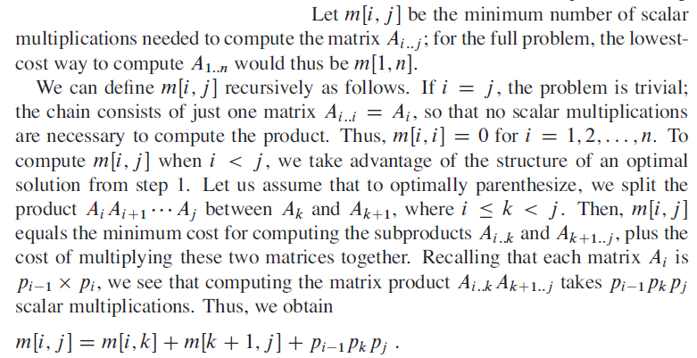
A recursive solution
(A_{i..k} )(A_{k+1..j} )
The order of the 2 product matrices within parentheses will be (p_{i-1}xp_{k} ) (p_{k+1}xp_{j} )
So number of scalar multiplications performed will be p_{i-1}xp_{k}xp_{j} where
p_{i-1} is the no of rows in A_{i} th matrix
p_{k} - No of cols in A_{k} th matrix
p_{j} – No of cols in A_{j} th matrix
Note:
p_{i-1} x p_{i}

Slide 14

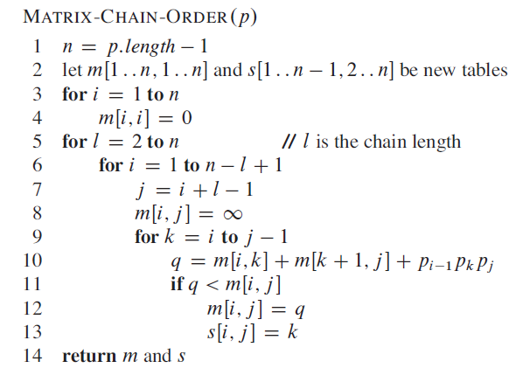
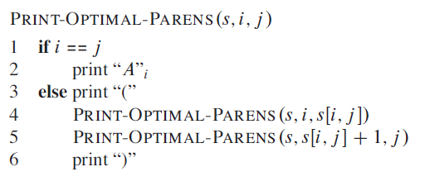
Algorithms
Recursive definition for finding minimum cost of parenthesizing ‘n’ matrices

Slide 15
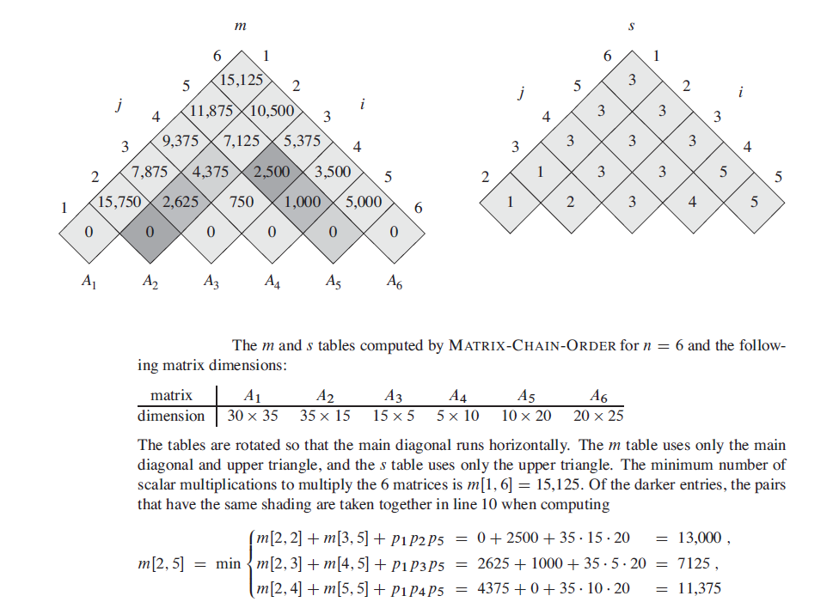
Tracing the algorithms for matrix chain multiplication

Slide 16
Runtime complexity of matrix chain multiplication
The matrix chain multiplication using dynamic programming strategy takes O(n³) computational complexity.

Slide 17
Maximum subarray –divide and conquer

Slide 18
-Contd

Slide 19
-Contd

Slide 20
-Contd

Slide 21
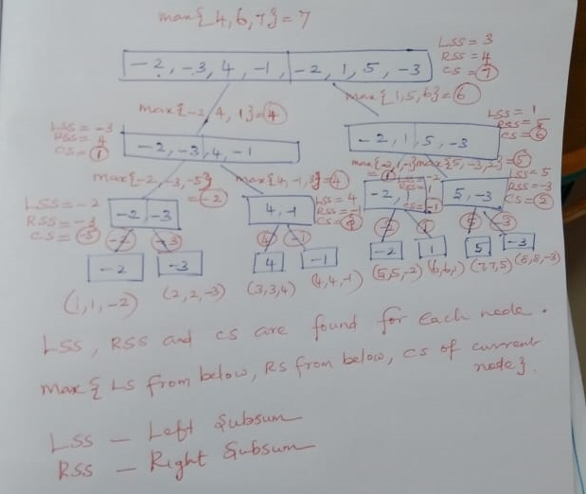

Slide 22
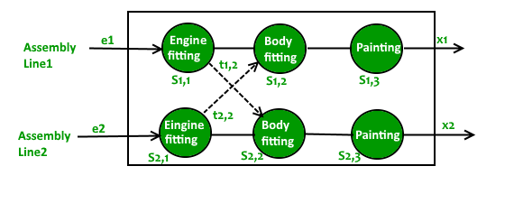
Assembly Line Scheduling

Slide 23
-Contd
A car factory has two assembly lines, each with n stations. A station is denoted by S_{i,j} where i is either 1 or 2 and indicates the assembly line the station is on, and j indicates the number of the station.
The time taken per station is denoted by a_{i,j}. Each station is dedicated to some sort of work like engine fitting, body fitting, painting, and so on. So, a car chassis must pass through each of the n stations in order before exiting the factory.
The parallel stations of the two assembly lines perform the same task. After it passes through station S_{i,j}, it will continue to station S_{i,j+1} unless it decides to transfer to the other line. Continuing on the same line incurs no extra cost, but transferring from line i at station j – 1 to station j on the other line takes time t_{i,j}.
Each assembly line takes an entry time e_{i} and exit time x_{i} which may be different for the two lines. Give an algorithm for computing the minimum time it will take to build a car chassis.

Slide 24
-Contd
If the minimum time taken by the chassis to leave station S_{i, j-1} is known, the minimum time taken to leave station S_{i, j} can be calculated quickly by combining a_{i, j} and t_{i, j}. T1(j) indicates the minimum time taken by the car chassis to leave station j on assembly line 1. T2(j) indicates the minimum time taken by the car chassis to leave station j on assembly line 2.
Base cases: The entry time e_{i} comes into picture only when the car chassis enters the car factory. Time taken to leave the first station is given by: T1(1) = Entry time in Line 1 + Time spent in station S_{1,1} T1(1) = e₁ + a_{1,1} Similarly, time taken to leave the first station is given by: T2(1) = e₂ + a_{2,1}

Slide 25
Recursive Relations: The car chassis at station S_{1,j} can come either from station S_{1, j-1} or station S_{2, j-1}.
Case #1: Its previous station is S_{1, j-1} The minimum time to leave station S_{1,j} is given by: T1(j) = Minimum time taken to leave station S_{1, j-1} + Time spent in station S_{1, j} T1(j) = T1(j-1) + a_{1, j}
Case #2: Its previous station is S_{2, j-1} The minimum time to leave station S1, j is given by: T1(j) = Minimum time taken to leave station S_{2, j-1} + Extra cost incurred to change the assembly line + Time spent in station S_{1, j} T1(j) = T2(j-1) + t_{2, j} + a_{1, j}
The minimum time T1(j) is given by the minimum of the two obtained in cases #1 and #2. T1(j) = min((T1(j-1) + a_{1, j}), (T2(j-1) + t_{2, j} + a_{1, j}))
Similarly, the minimum time to reach station S2, j is given by: T2(j) = min((T2(j-1) + a_{2, j}), (T1(j-1) + t_{1, j} + a_{2, j}))
The total minimum time taken by the car chassis to come out of the factory is given by: Tmin = min(Time taken to leave station S_{i,n} + Time taken to exit the car factory) Tmin = min(T1(n) + x₁, T2(n) + x₂)

